Slide 1
Kickstarter NLP
Presented by: walid Moussa

Slide 2
Problem definition
Predict If a project will fail or succeed depending on its short description.

Slide 3

Data Set
The datastet contains the blurbs or short description of 215513 projects runned along 2017, all written in english and all labeled with "successful" or "failed", if they get the money or not, respectively.
Sample of data:

Slide 4
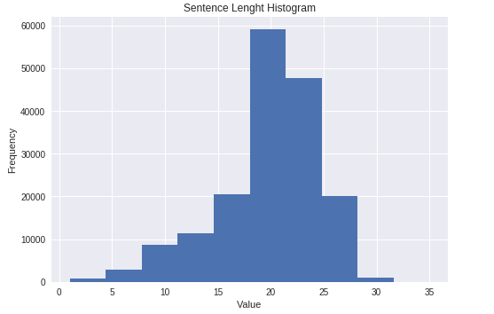
Data Visualization

Slide 5
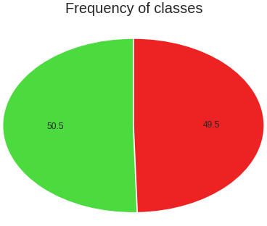
Data Visualization
Successful
Failed

Slide 6
Data preprocessing:
Used Tokenizer class in Keras to:
Remove punctuation.
Put all words in lower case
Represent words as indices to be passed to the embedding layer

Slide 7
Train,Dev and Test sets
Type | Percentage | Number of Records
Train | 80% | 172411
Dev | 10% | 21551
Test | 10% | 21551
Total | 100% | 215513

Slide 8
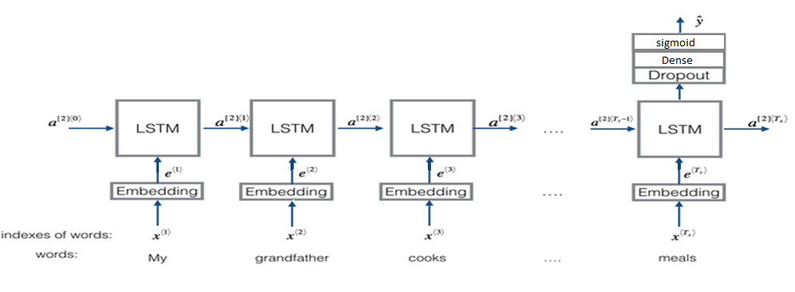
Model

Slide 9
Models comparison
Model | LSTM hidden layer Units | Max Sentence Length | Embeddings Trainable? | Number Of Epochs | Validation Set Accuracy
1 LSTM Layer 1 Dense Layers | 128 | 35 | YES | 2 | 63.9%
1 LSTM Layer 1 Dense Layers | 128 | 28 | YES | 3 | 67.4%
1 LSTM Layer 1 Dense Layers | 128 | 28 | NO | 15 | 67%
1 LSTM Layer 1 Dense Layers | 64 | 28 | NO | 18 | 66.8%
2LSTM Layers | 64 | 28 | NO | 15 | 66%

Slide 10
Final Result
when applied on test set the results were:
accuracy: 67.91%
recall: 70.1%
Precision: 67.6%
This result is fair enough because knowing whether the project is going to succeed of fail based on 35 description words is a hard task even for humans.
Confusion matrix:
predicted \actual | True | False
True | 7638 | 3647
False | 3268 | 6998

